Slide 1
CSE 109 Electrical Circuits
Dr. Md. Forkan Uddin
Associate Professor
Department of Electrical and Electronic Engineering (EEE)
Bangladesh University of Engineering and Technology (BUET)

Slide 2
AC Circuits: Phasors and Vector Diagrams (Chapter 9 – Alexander)

Slide 3
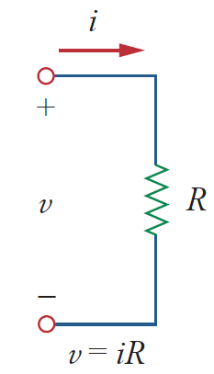
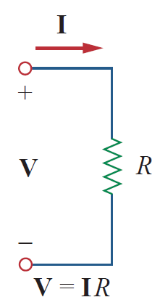
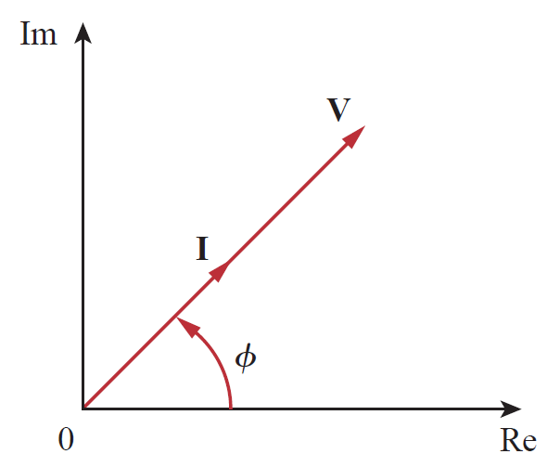

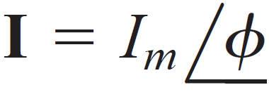



Voltage-Current Phasors: R (Resistor)
Time domain
Phasor / Frequency domain
Phasor Diagram

Slide 4
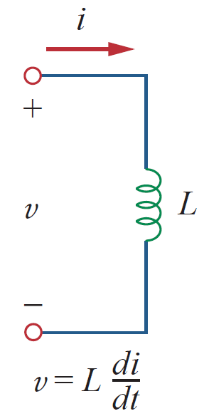
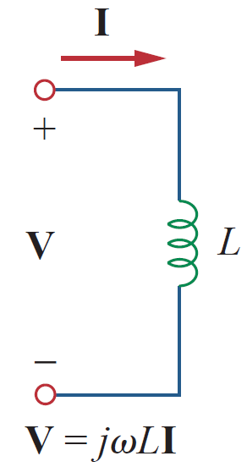
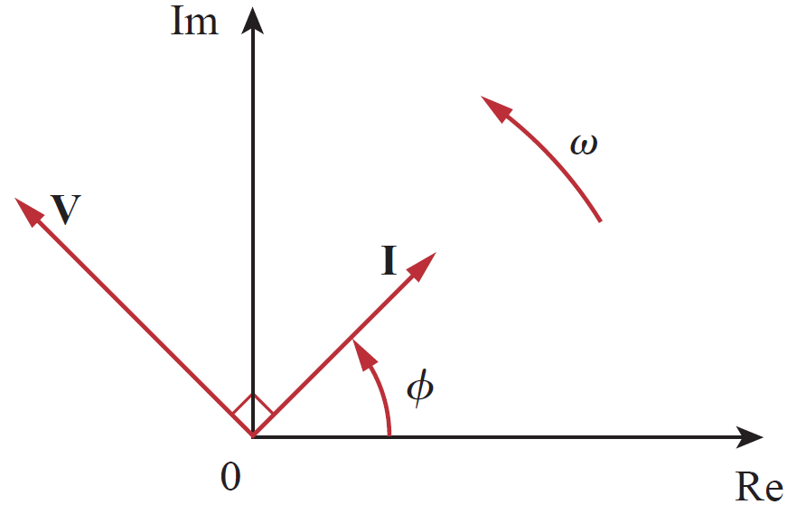




Voltage-Current Phasors: L (Inductor)
Time domain
Phasor/Frequency domain
Phasor Diagram

Slide 5
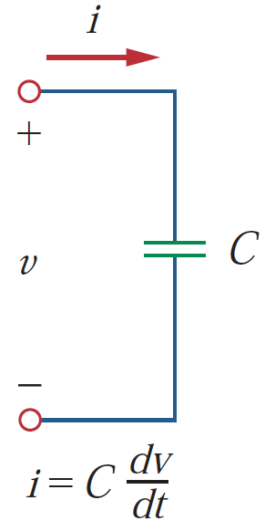
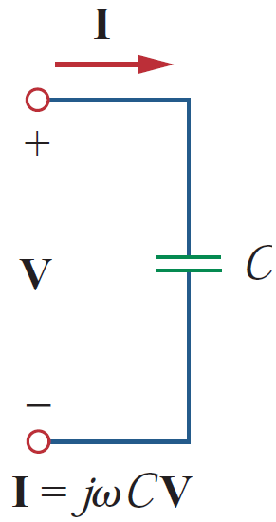
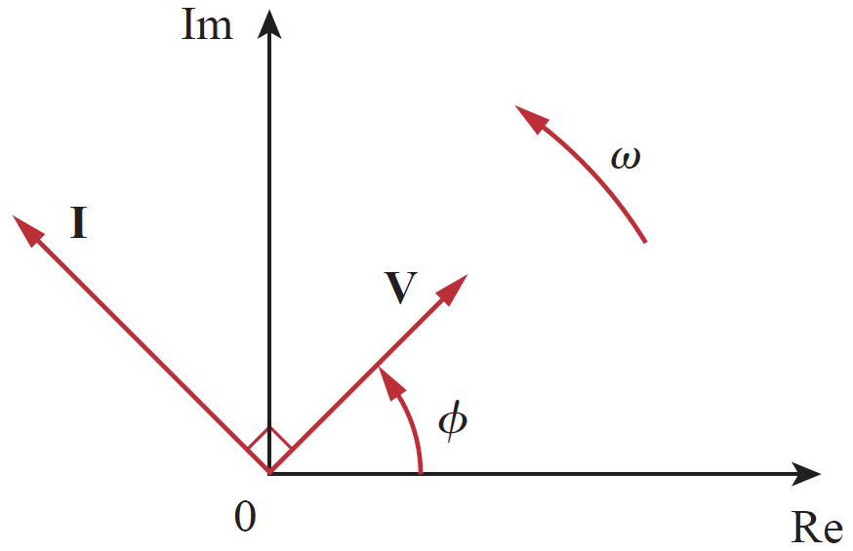
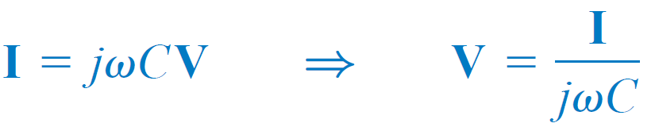
Voltage-Current Phasors: C (Capacitor)
Time domain
Phasor/Frequency domain
Phasor Diagram

Slide 6
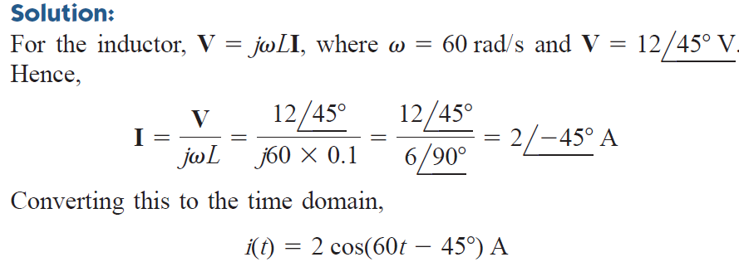
Example

Slide 7
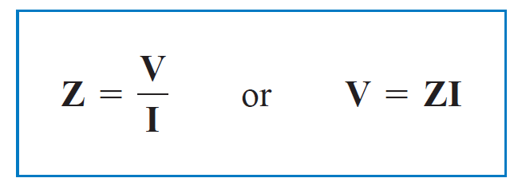
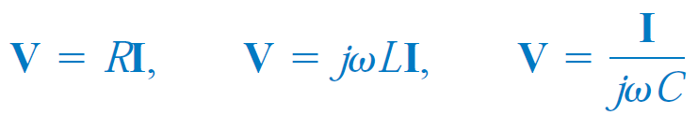
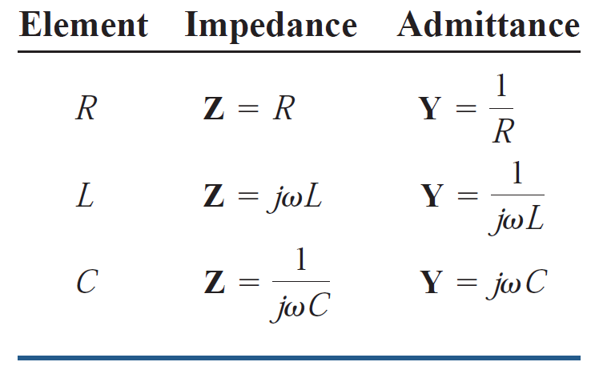
Impedance

Slide 8
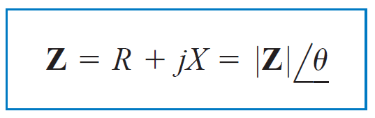
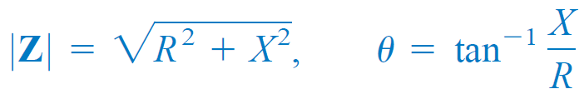

Impedance
R: Resistance (ohm)
X: Reactance (ohm)
R is always positive
Z falls in 1st or 4th quadrant

Slide 9
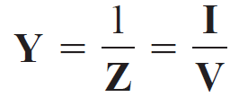

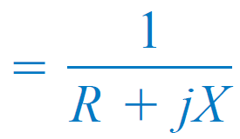
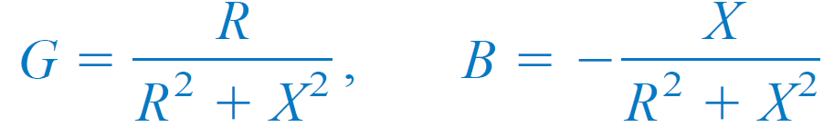
Admittance
G: Conductance (mho)
B: Susceptance (mho)

Slide 10
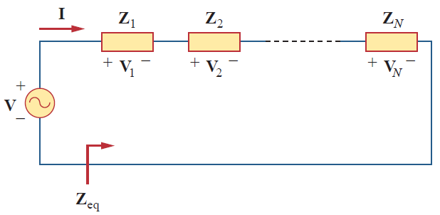

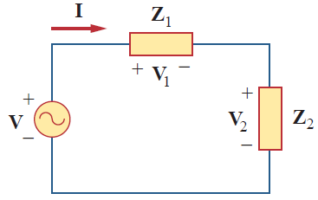
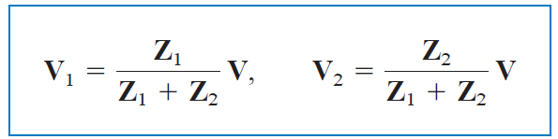
Series Impedance
Voltage Divider Rule (VDR)

Slide 11
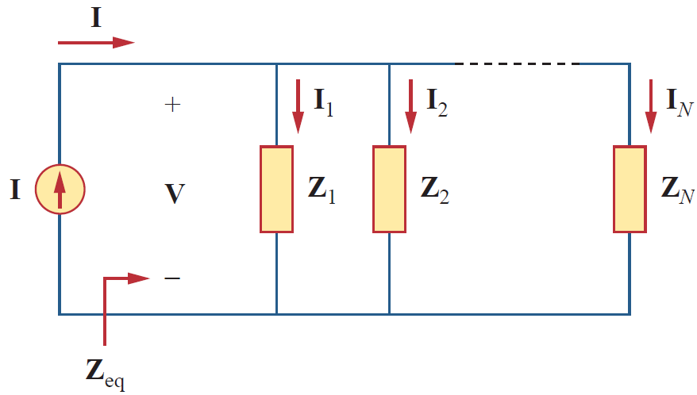
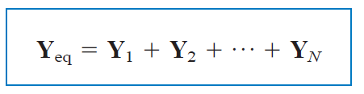
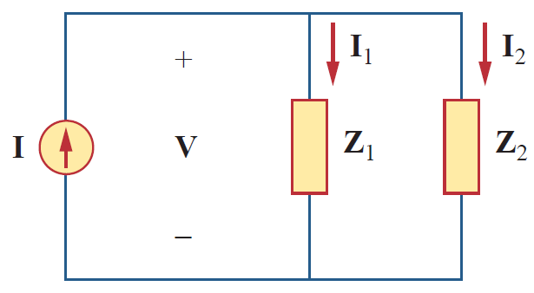
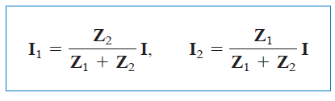
Parallel Impedance
Current Divider Rule (CDR)

Slide 12
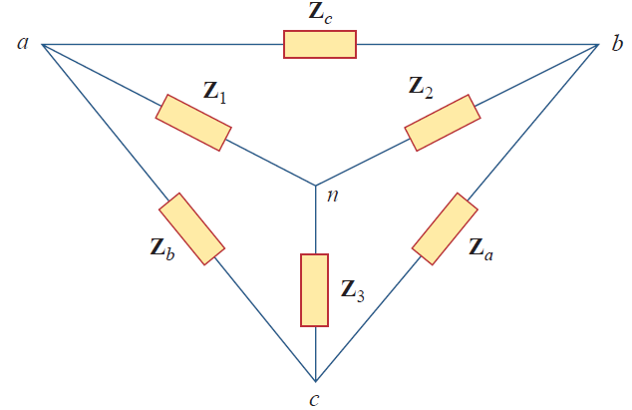


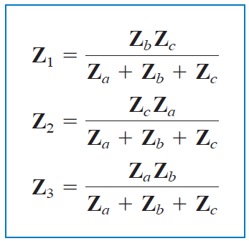
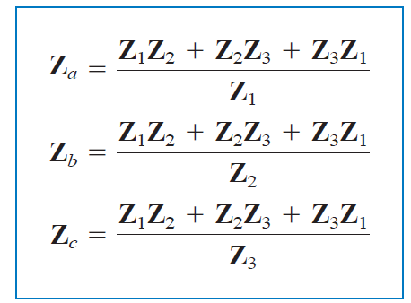
WYE (Y)-DELTA (Δ) Conversion

Slide 13
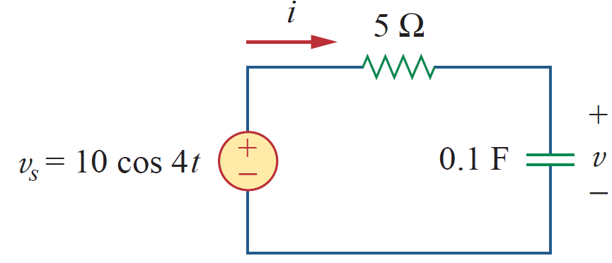
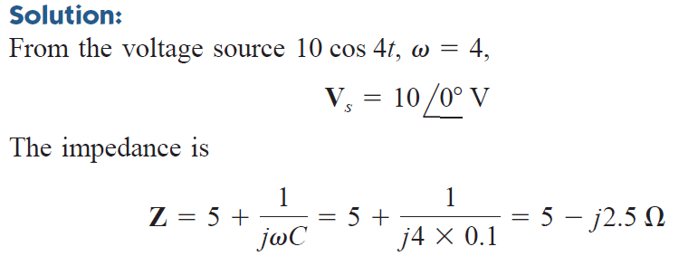
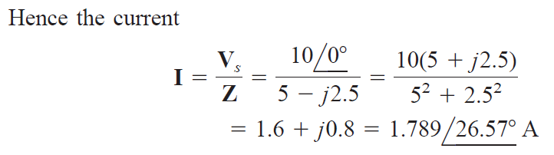
Example

Slide 14
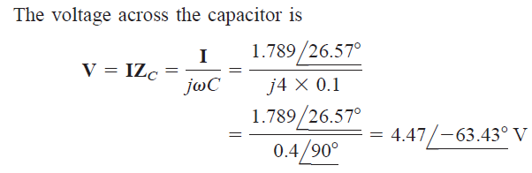
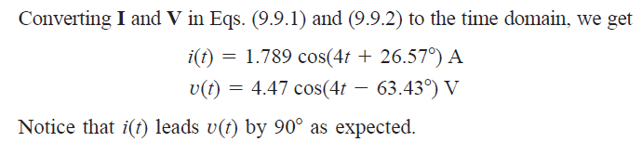
Example

Slide 15
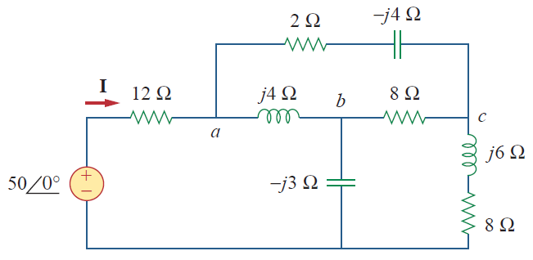
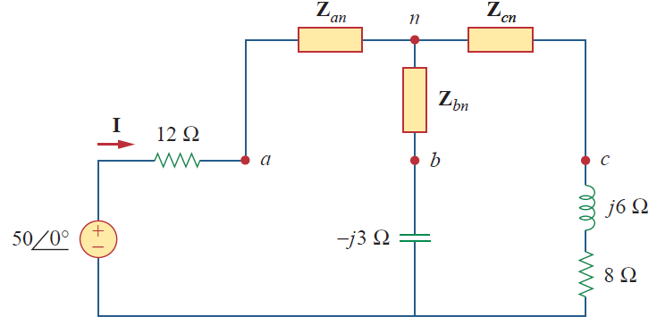
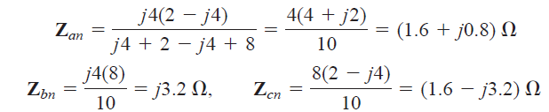
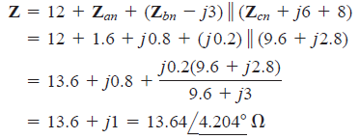

Example
Find I and i(t)

Slide 16



KVL and KCL in Phasor Domain
(KVL)
(KVL)
I₁ + I₂ + … + I_{n} = 0
(KCL)
Similarly,

Slide 17
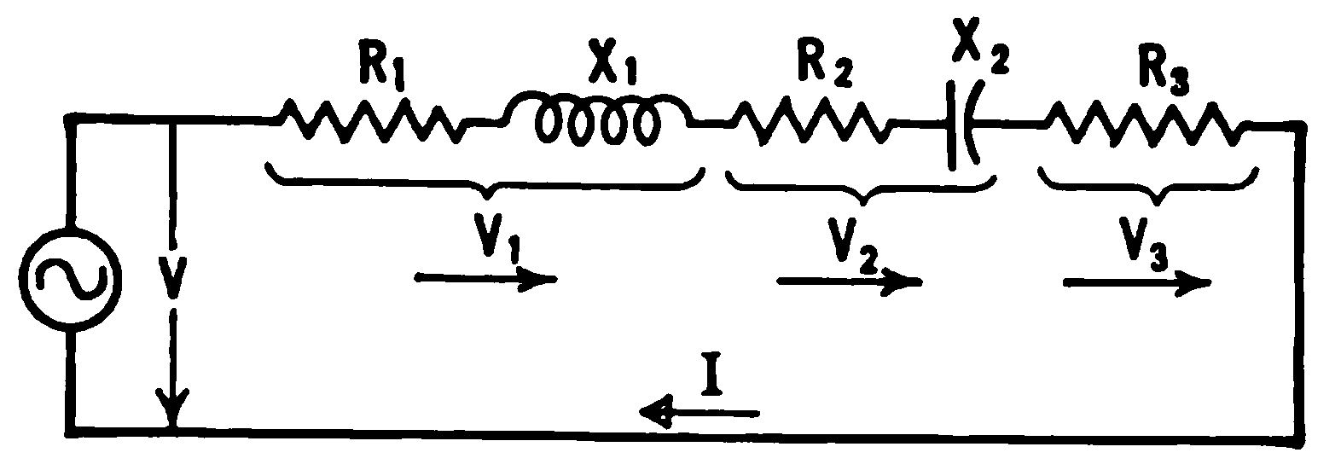

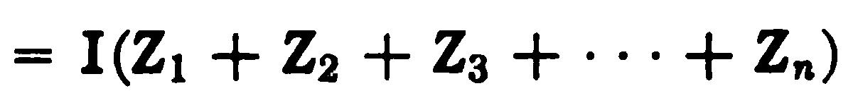
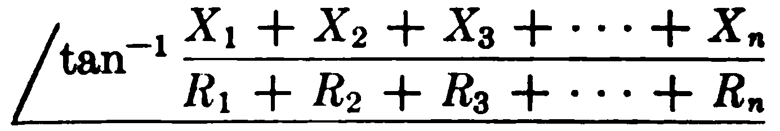
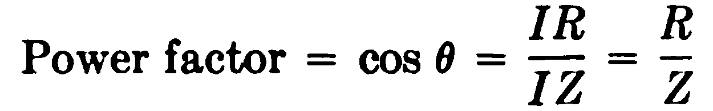
Phasor Diagram (Chapter 5 - Corcoran)
Phasor Diagram
Series circuit
Total Impedance

Slide 18
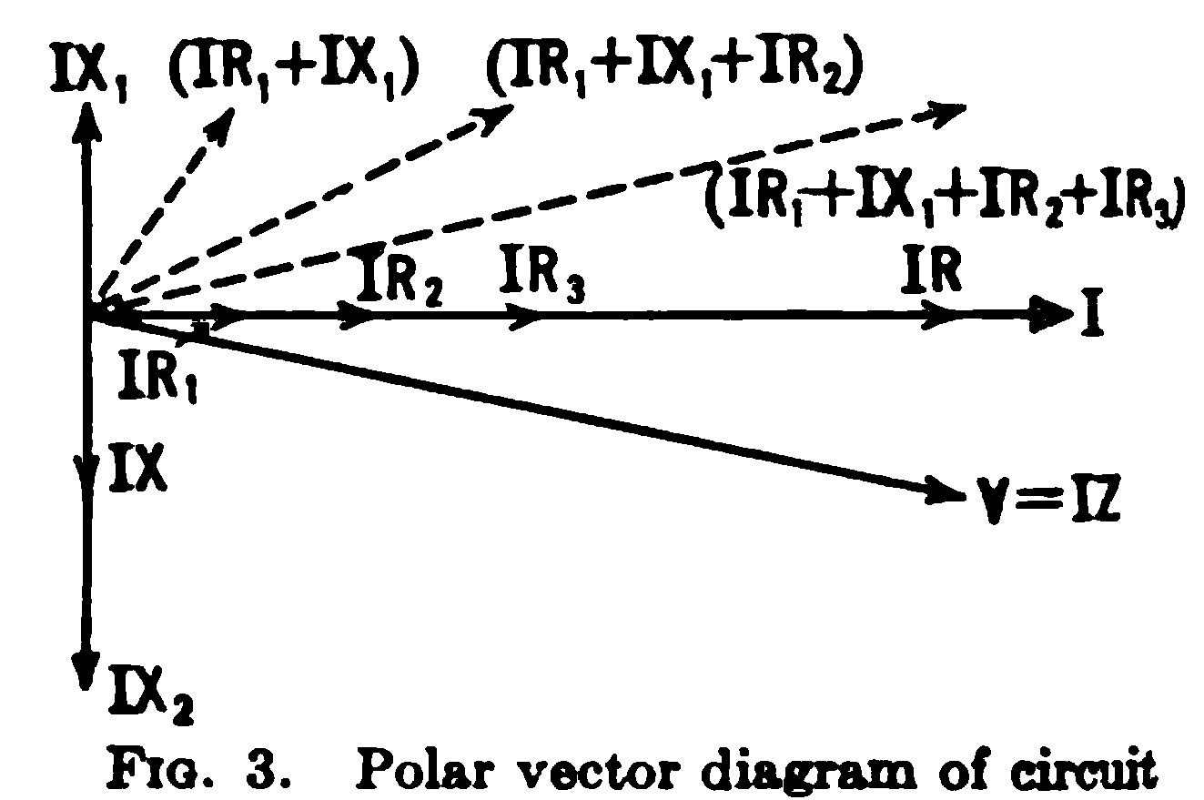
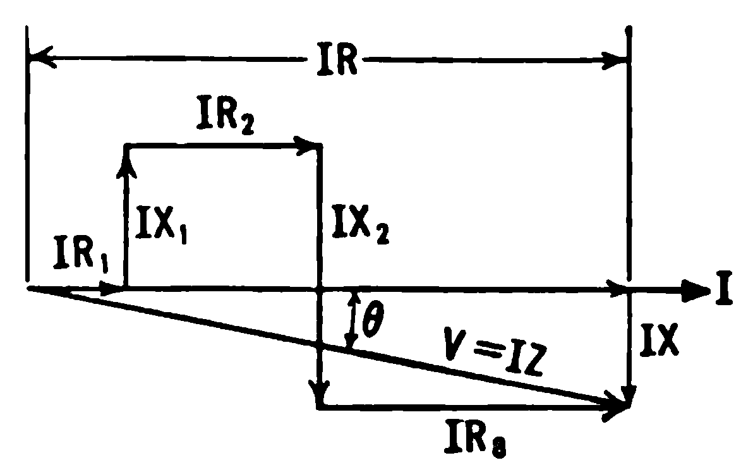
Phasor Diagram (Chapter 5 - Corcoran)
Funicular / String Vector Diagram

Slide 19
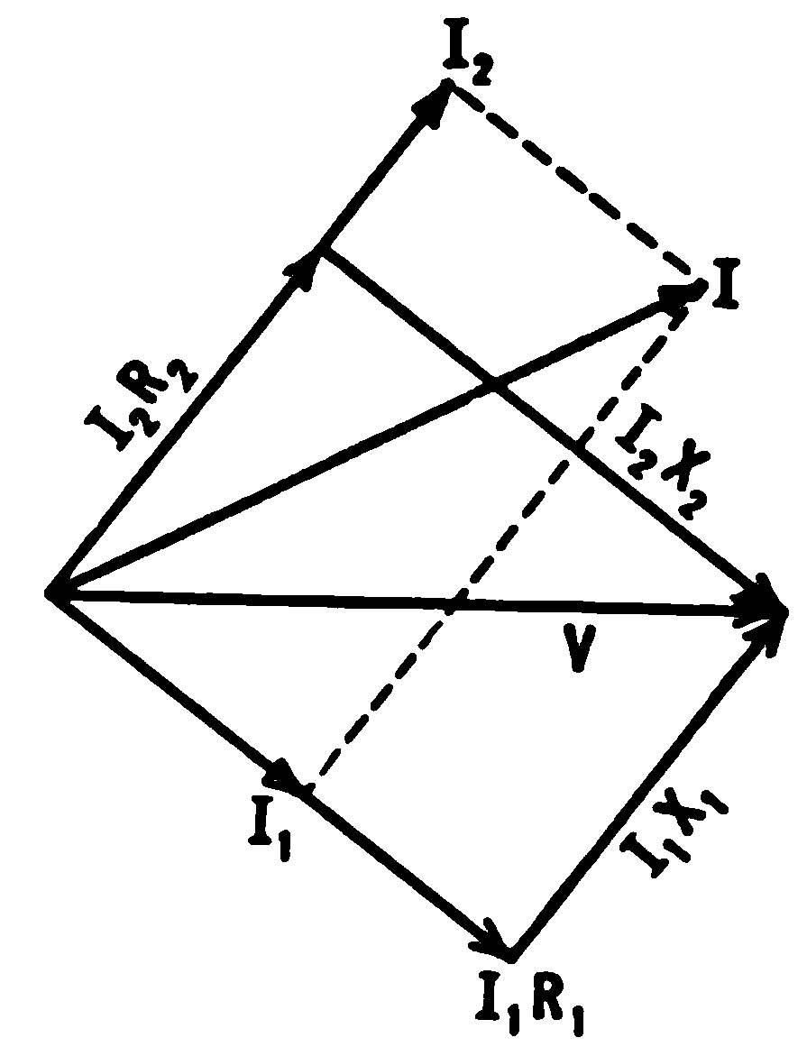
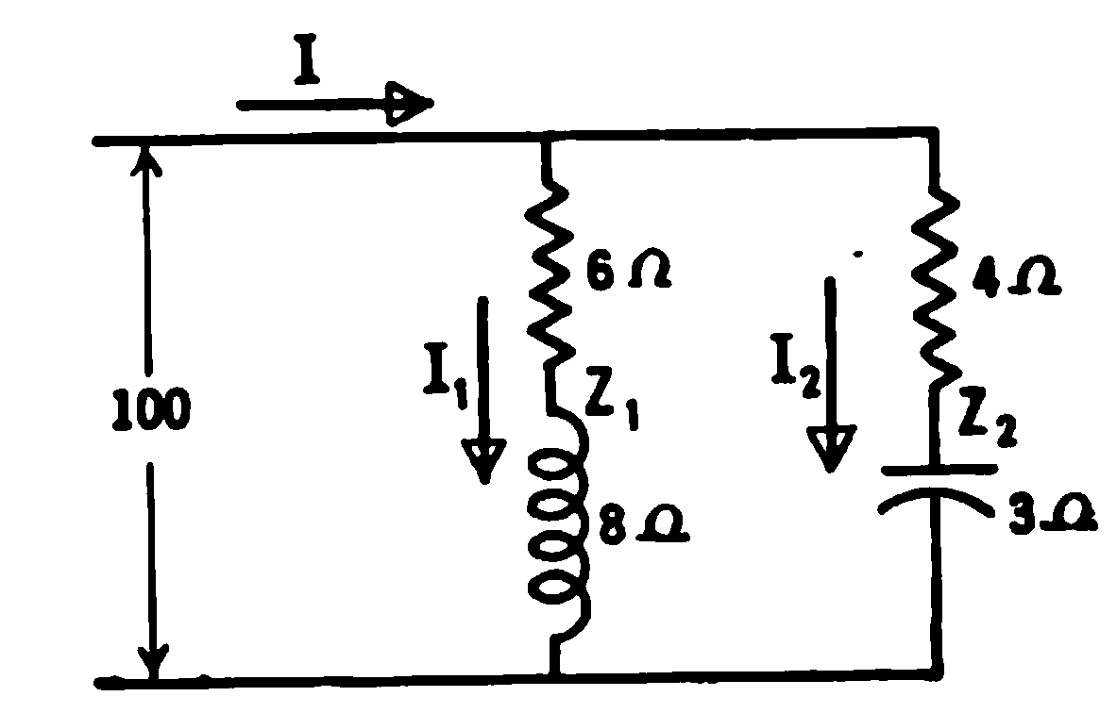
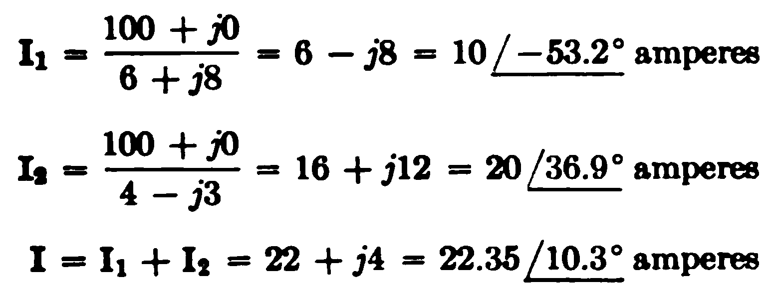
Phasor Diagram (Chapter 5 - Corcoran)
Example: (a) Calculate all the unknown currents and voltages, (b) calculate the conductance and susceptance of each branch, and (c) draw the vector diagram. Consider the applied voltage as the reference.
Parallel circuit
G₁ = 0.06 mho, B₁ = -0.08 mho
G₂ = 0.16 mho, B₂ = 0.12 mho

Slide 20
Network Theorems and Analysis Methods
Superposition Theorem
Nodal Analysis including Supernode
Mesh (loop) Analysis including Supermesh
Thevenin Equivalent Circuit
Norton Equivalent Circuit
Procedures are exactly same as studied in DC Circuits

Slide 21
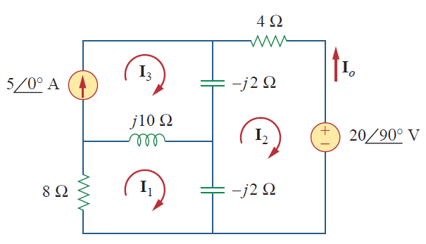


Example
Use (a) mesh analysis, (b) nodal analysis, (c) superposition principle for I₀

